Slide 1
Glow up co. Ahmed Ashraf

Slide 2
Project analysis slide 2
Project Analysis
Overview
PROJECT
Merging and cleaning using Excel
Data Preprocessing using Python
Visualization using Power Bi

Slide 3
Project analysis slide 3
Overview
this dataset belongs to a mid-sized beauty and wellness company named GlowUp Co., which operates across the U.S. through a network of 72 energetic sales representatives. Each quarter, reps log transactions related to the sales of 12 flagship products.

Slide 4
Excel

Slide 5
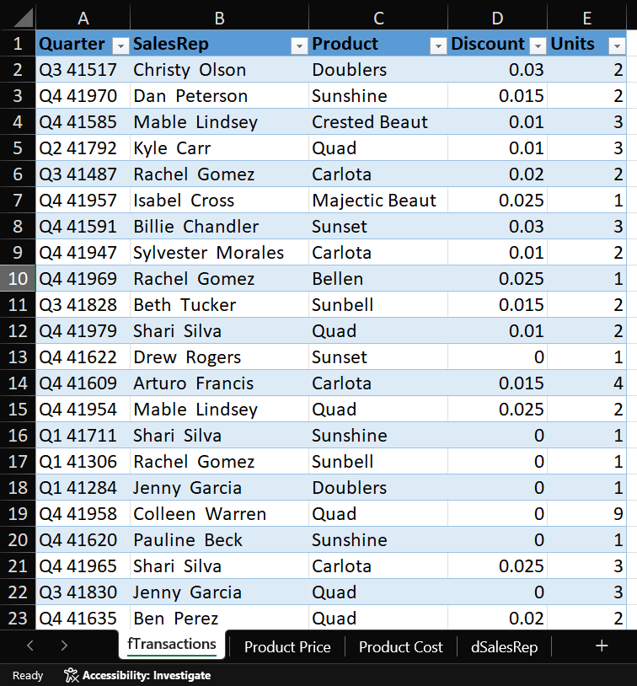
Project analysis slide 4
Excel

Slide 6
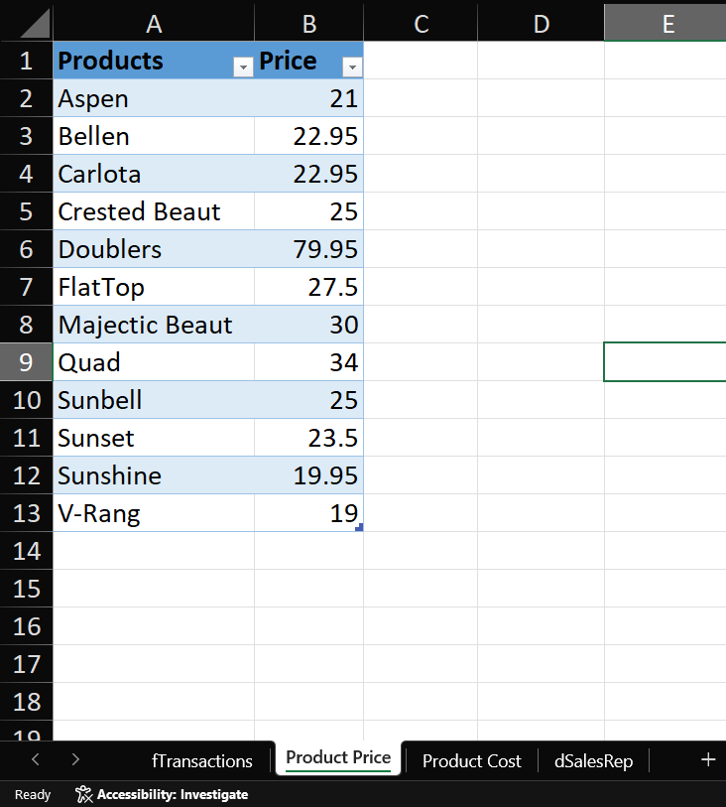
Project analysis slide 4
Excel

Slide 7
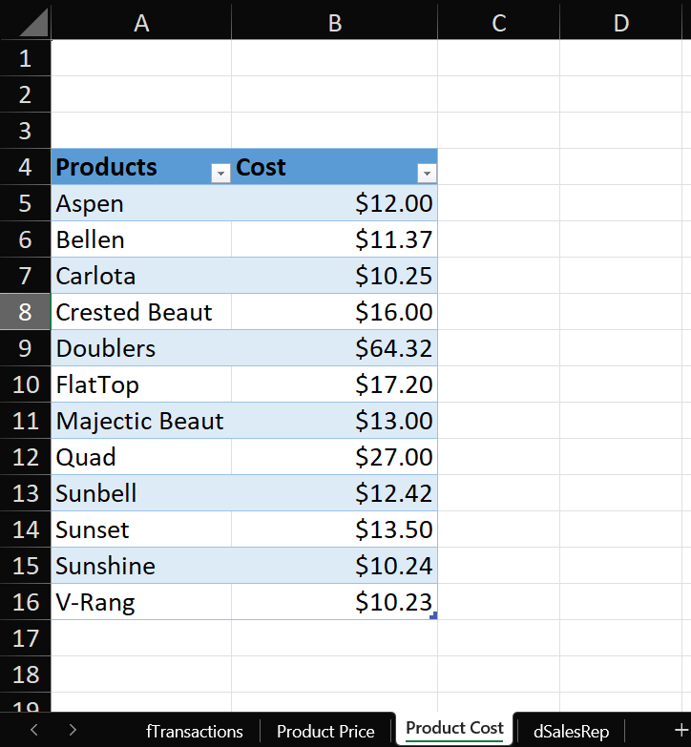
Project analysis slide 4
Excel

Slide 8
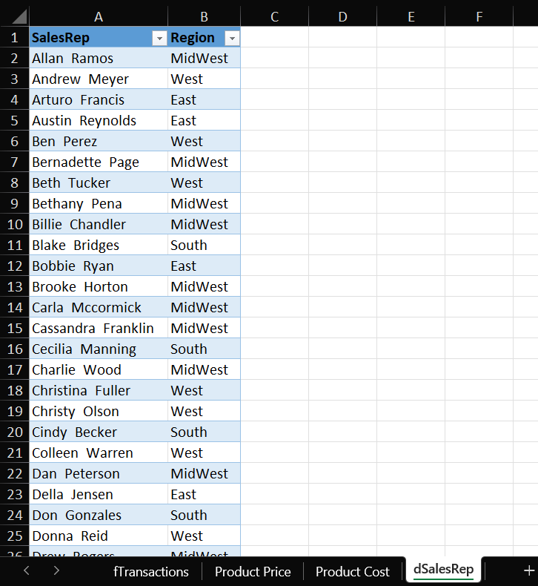
Project analysis slide 4
Excel

Slide 9
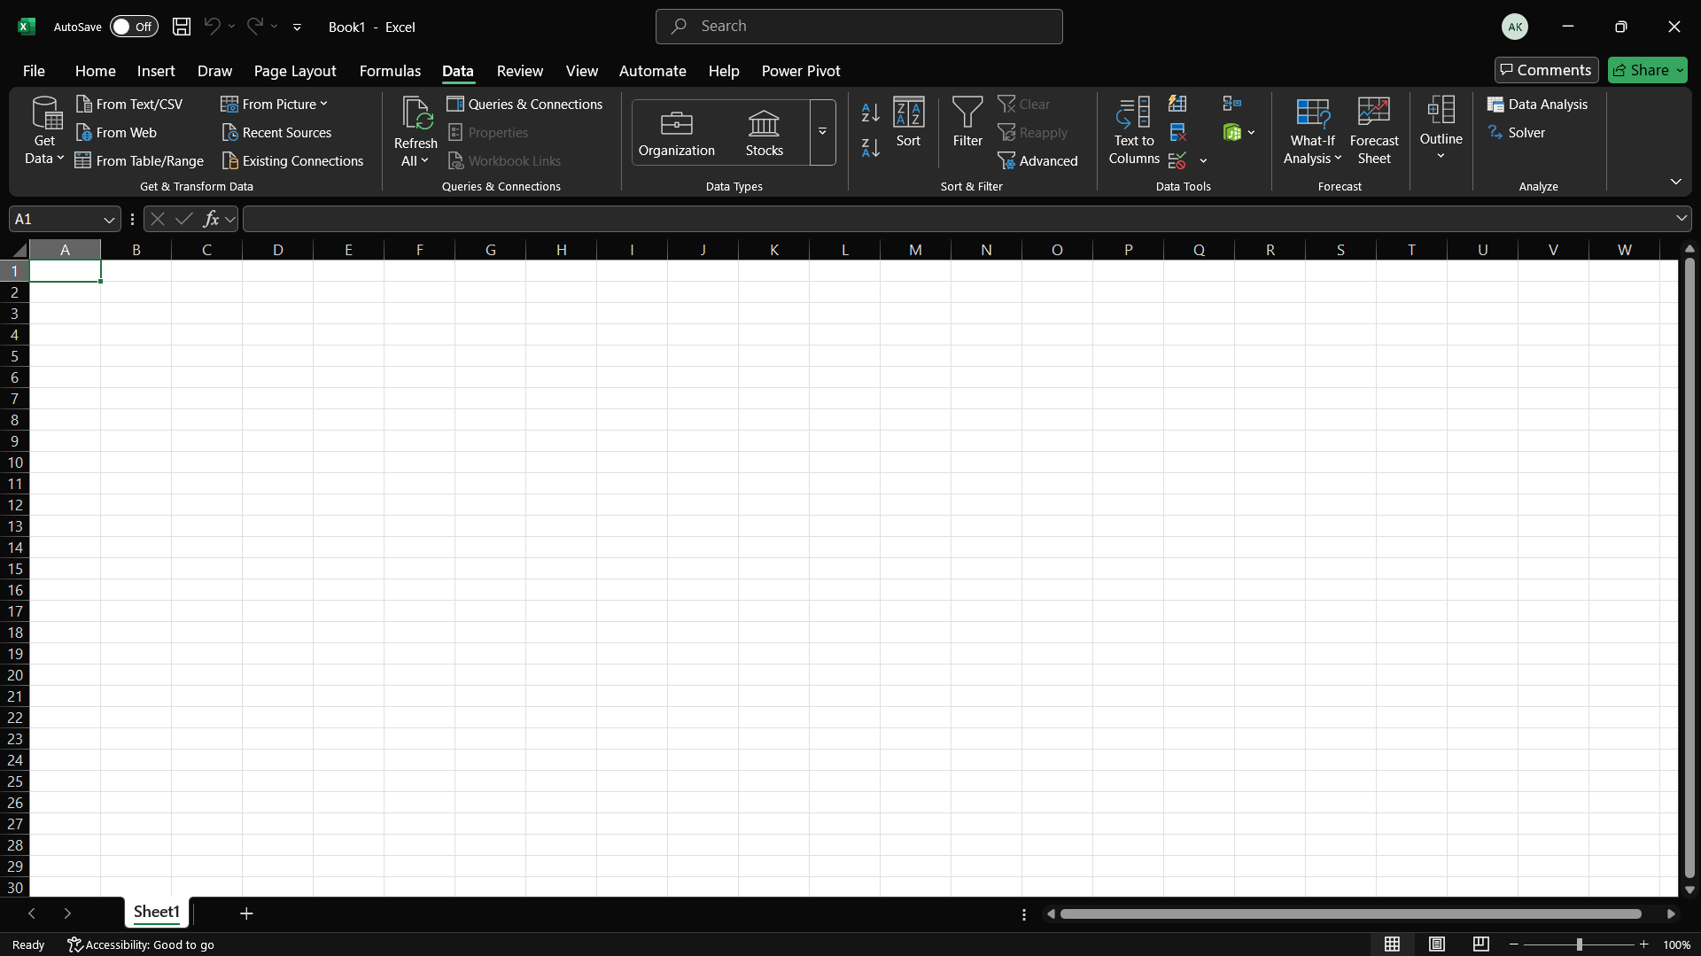
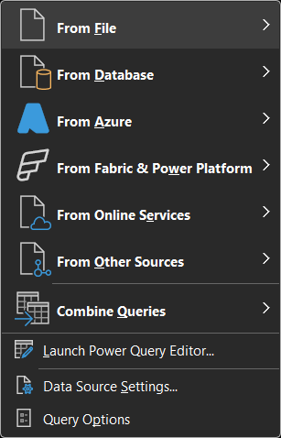

Project analysis slide 4
Excel

Slide 10
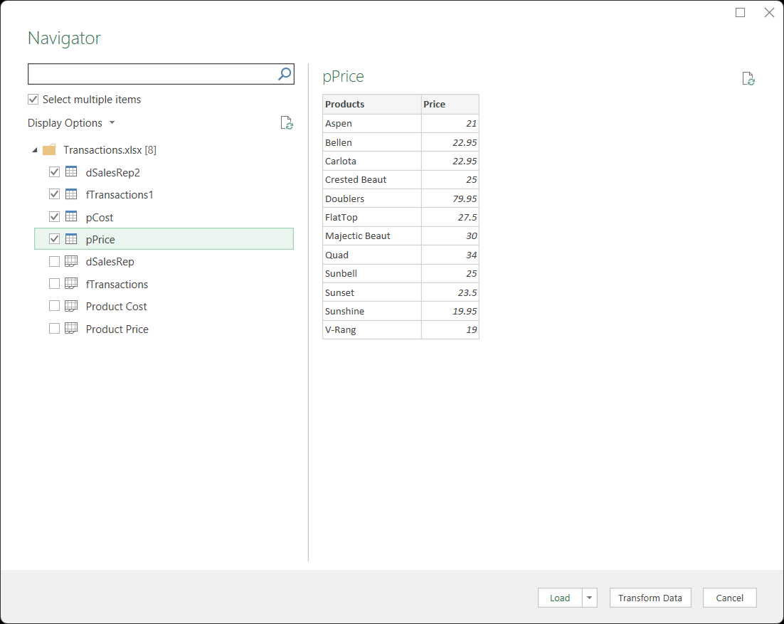

Project analysis slide 4
Excel

Slide 11
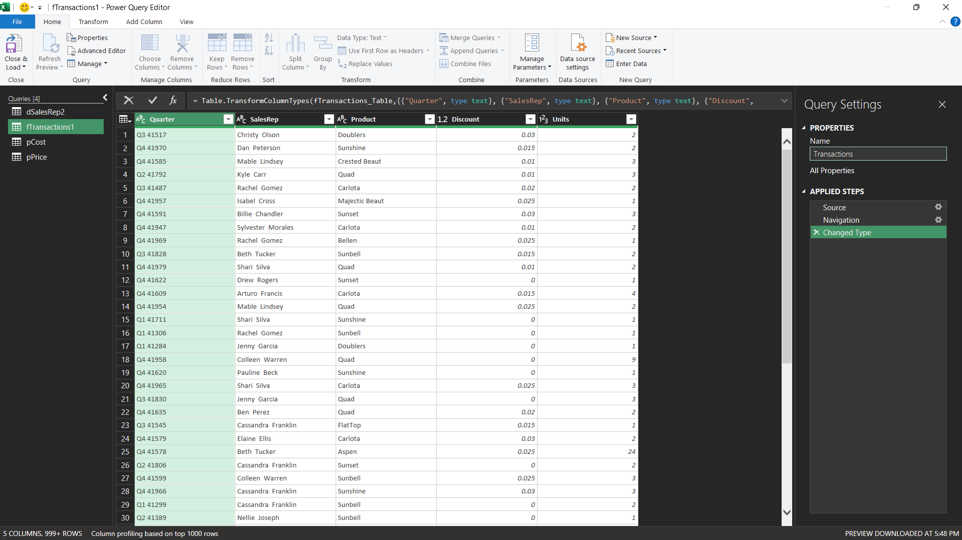

Project analysis slide 4
Excel

Slide 12
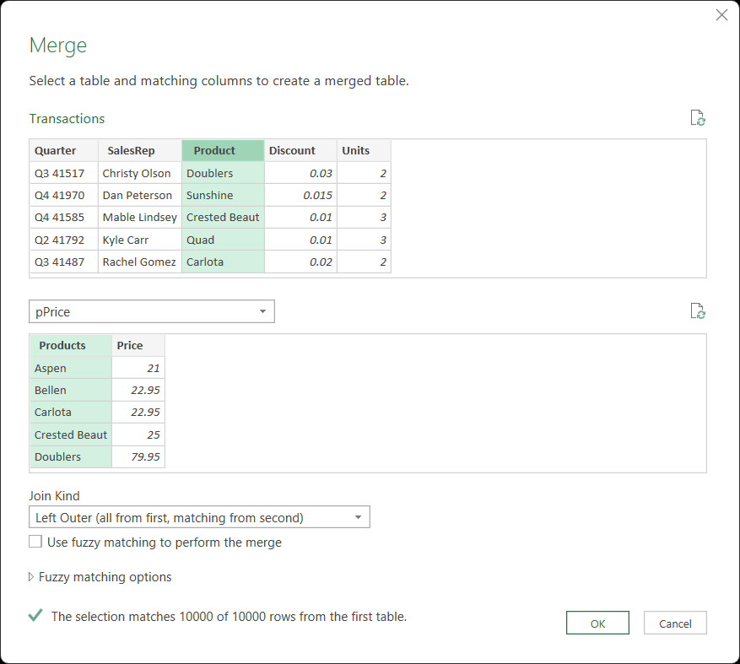
Project analysis slide 4
Excel

Slide 13
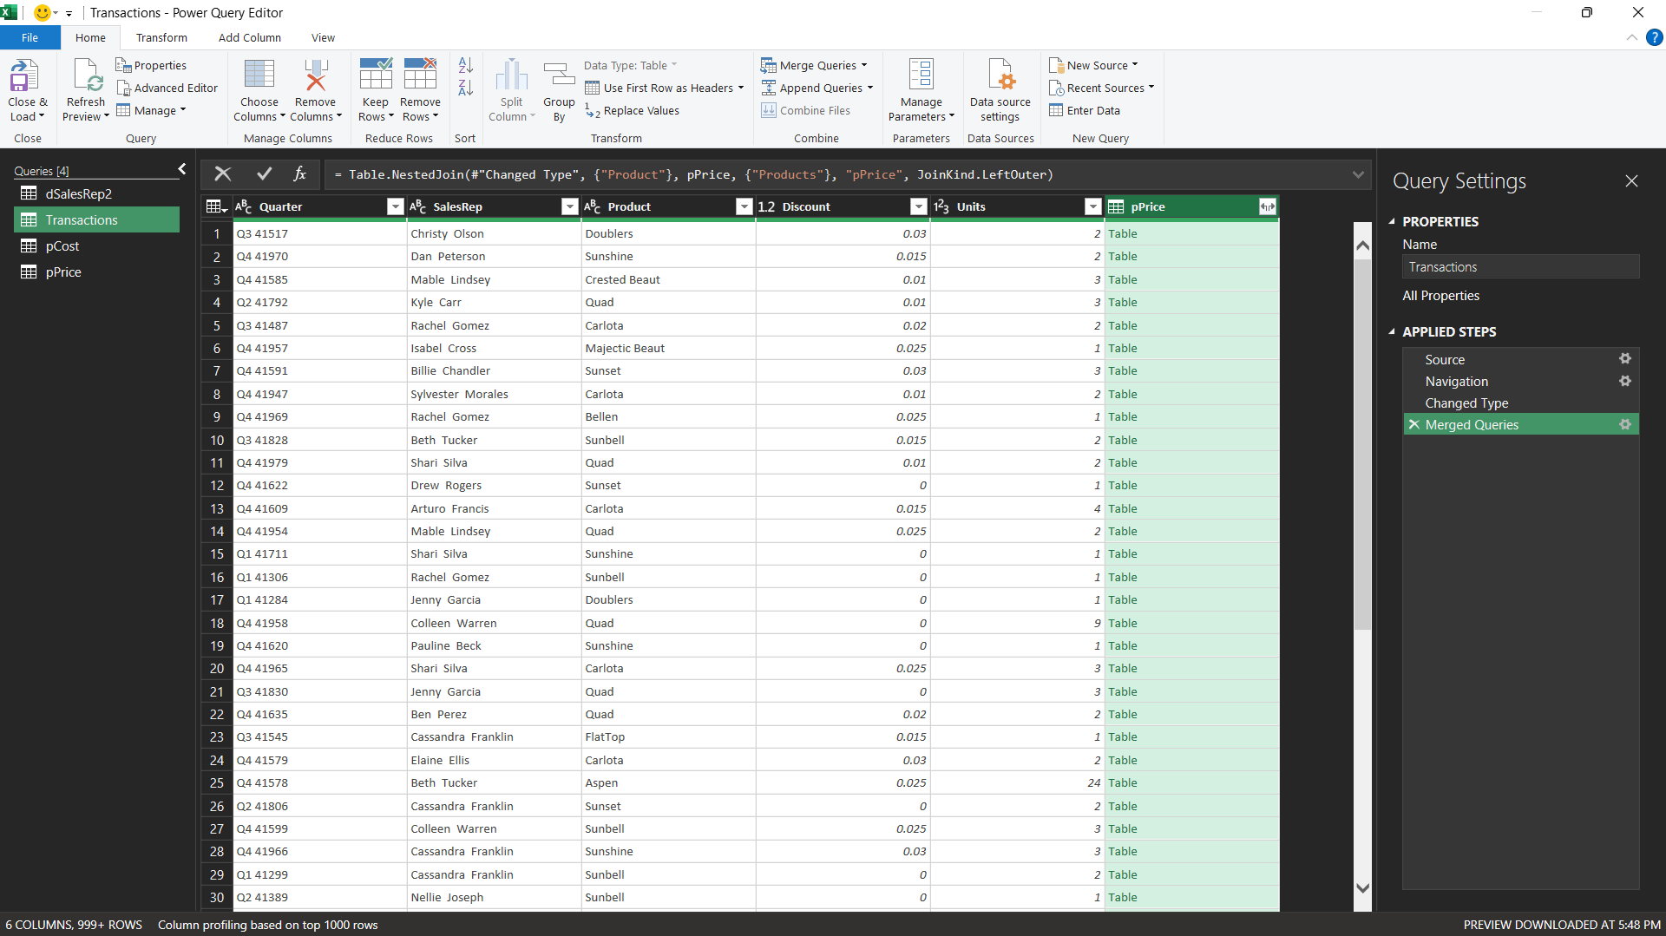
Project analysis slide 4
Excel

Slide 14
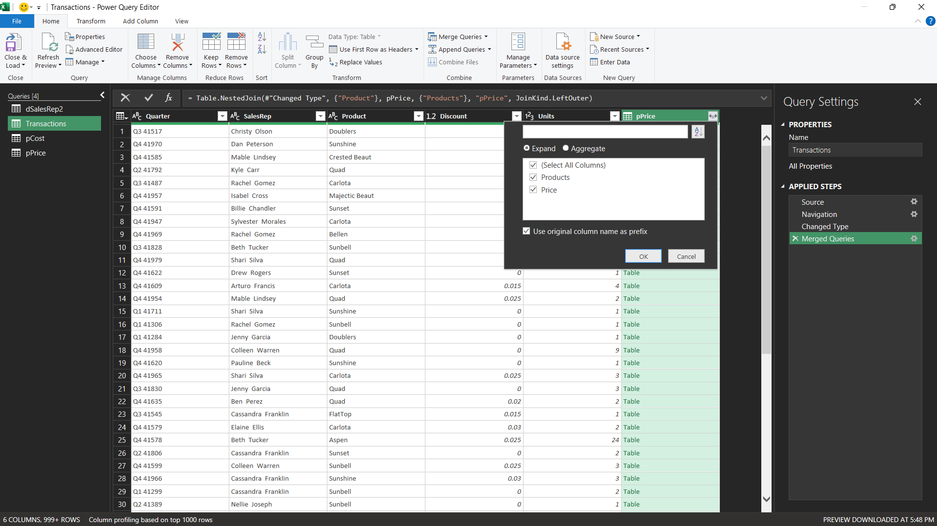
Project analysis slide 4
Excel

Slide 15
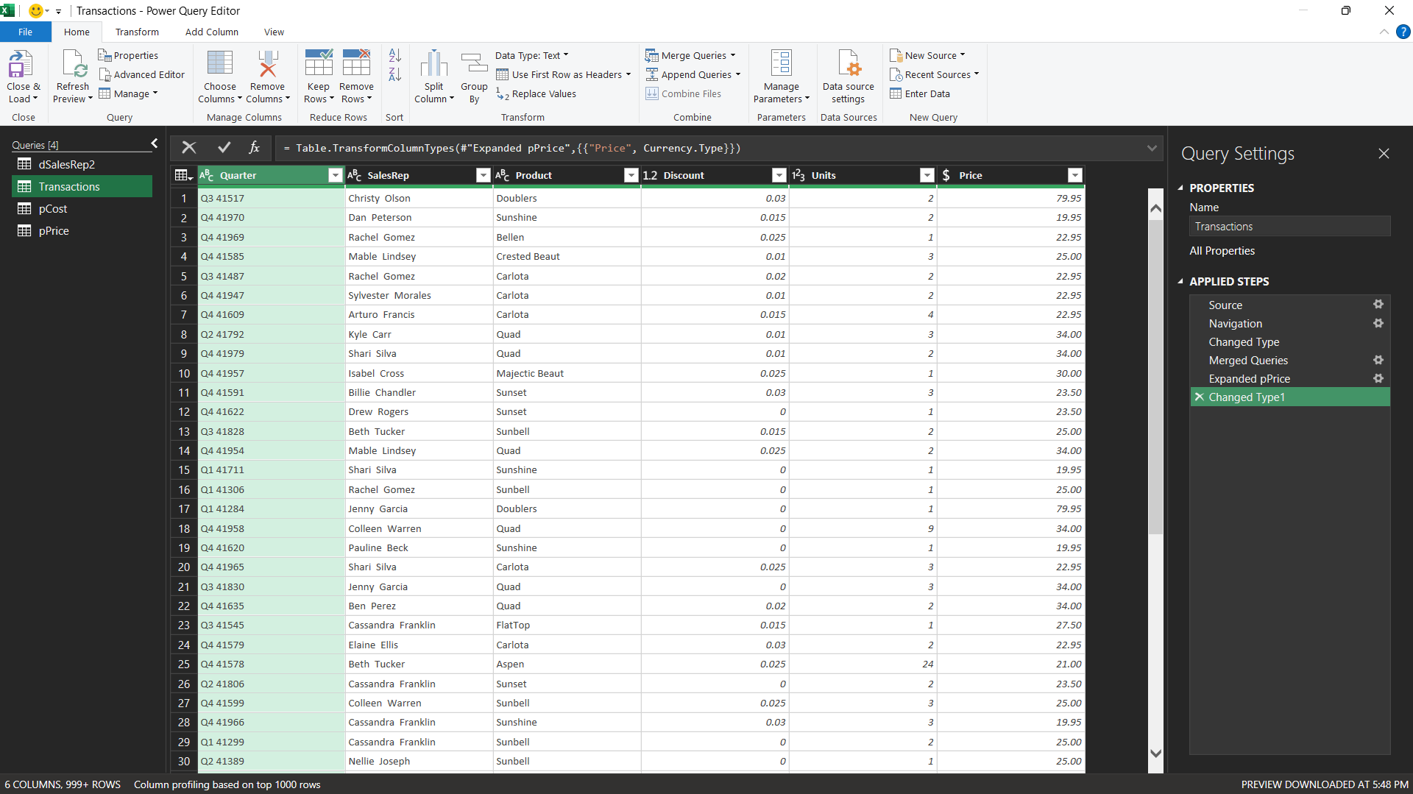
Project analysis slide 4
Excel

Slide 16
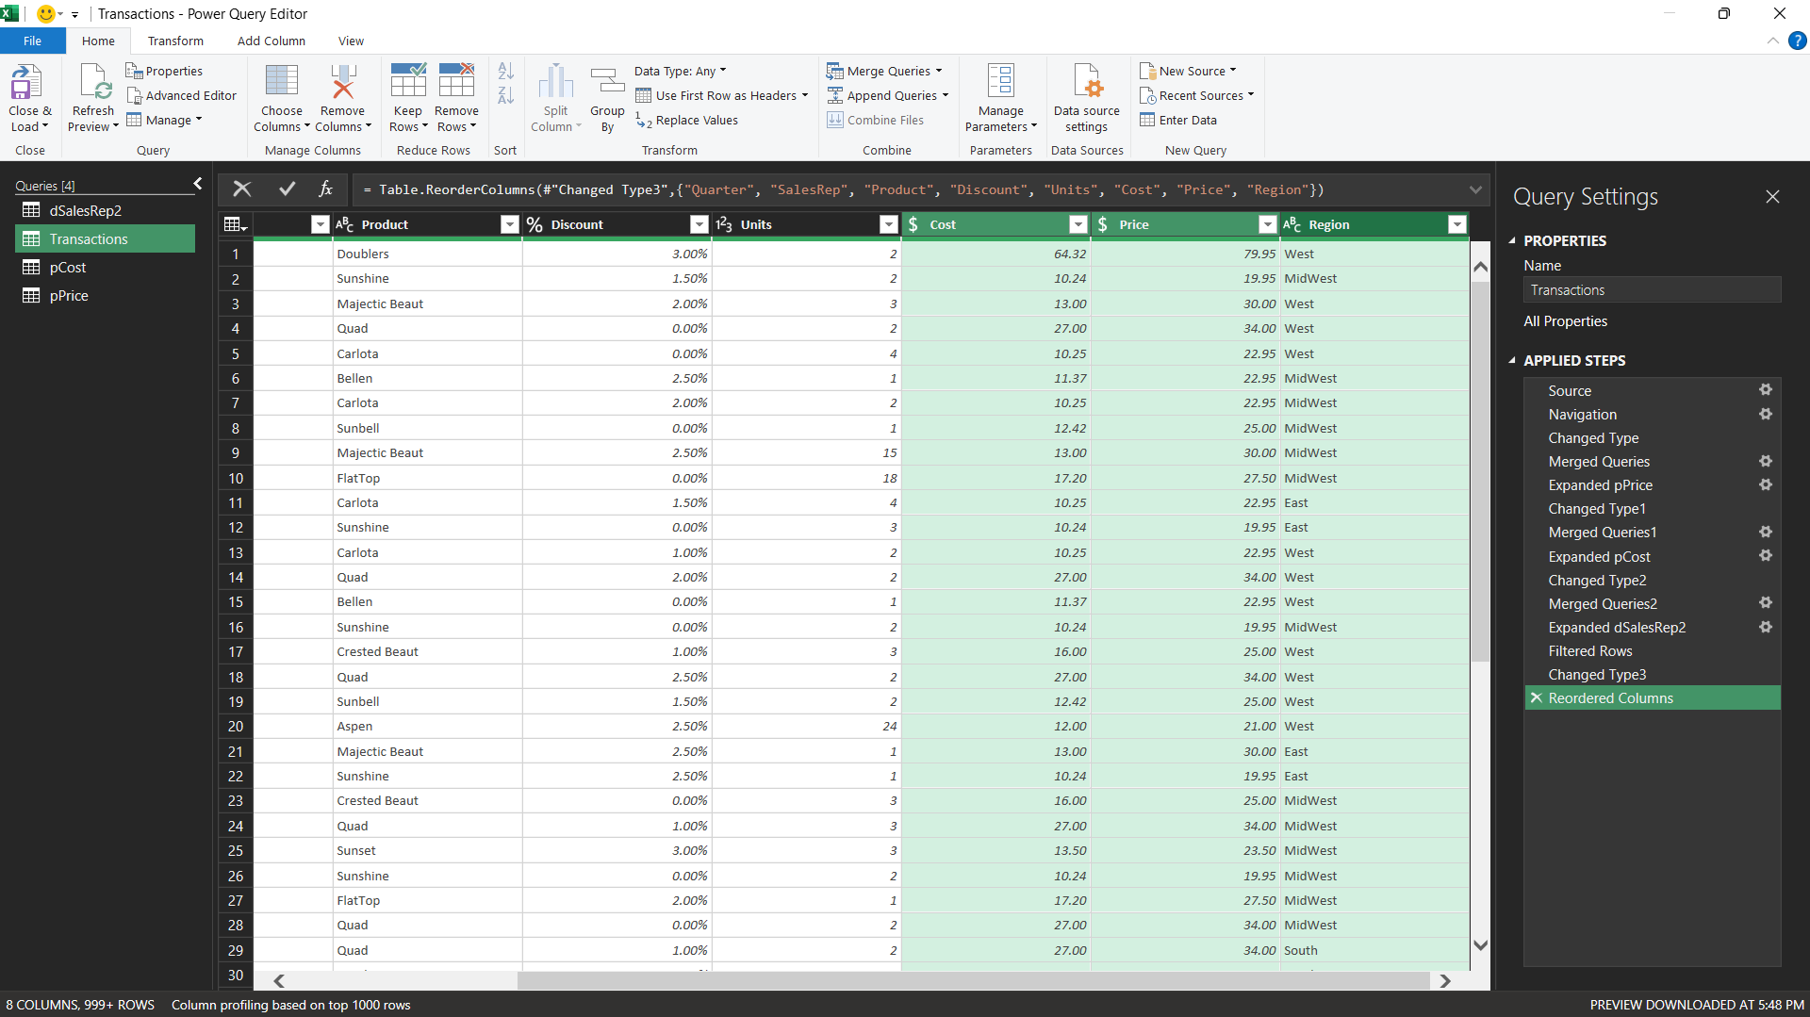
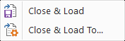

Project analysis slide 4
Excel

Slide 17
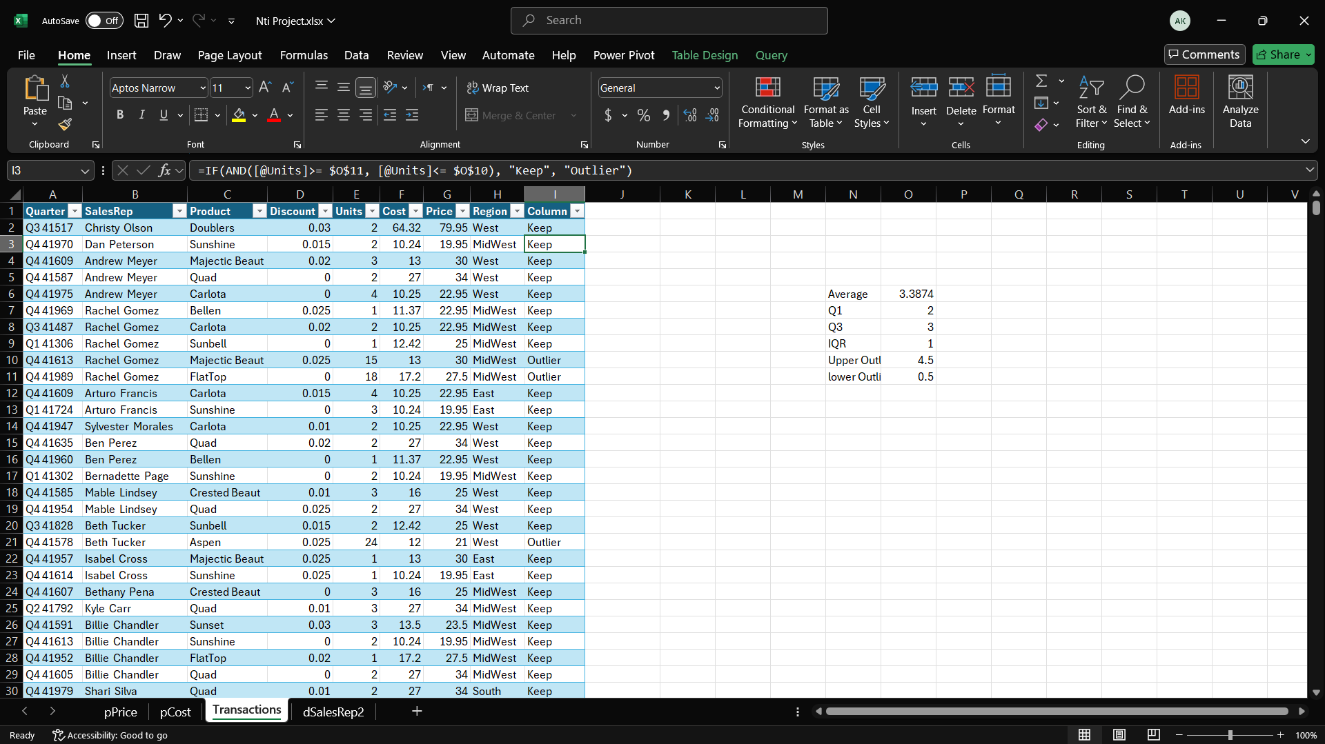

Project analysis slide 4
Excel

Slide 18
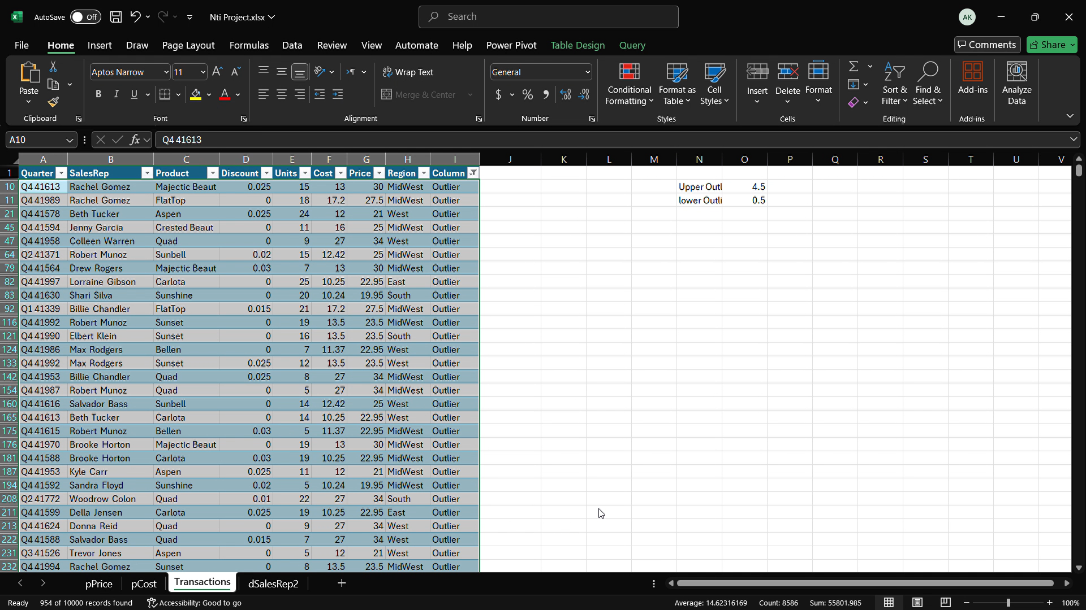
Project analysis slide 4
Excel

Slide 19
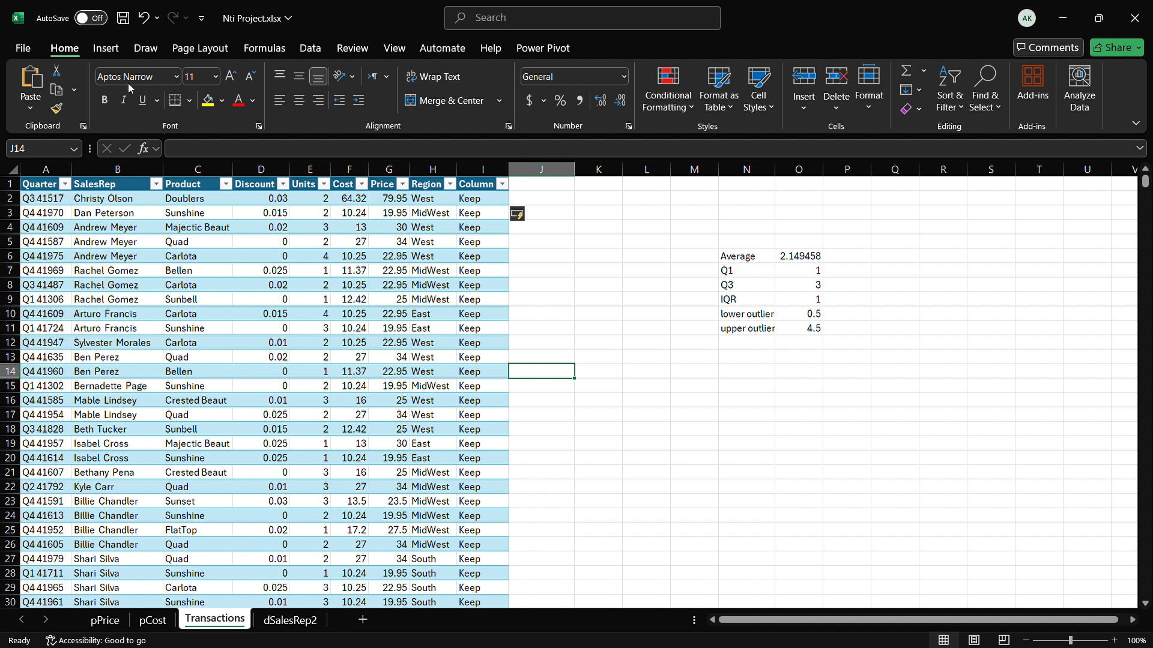
Project analysis slide 4
Excel

Slide 20
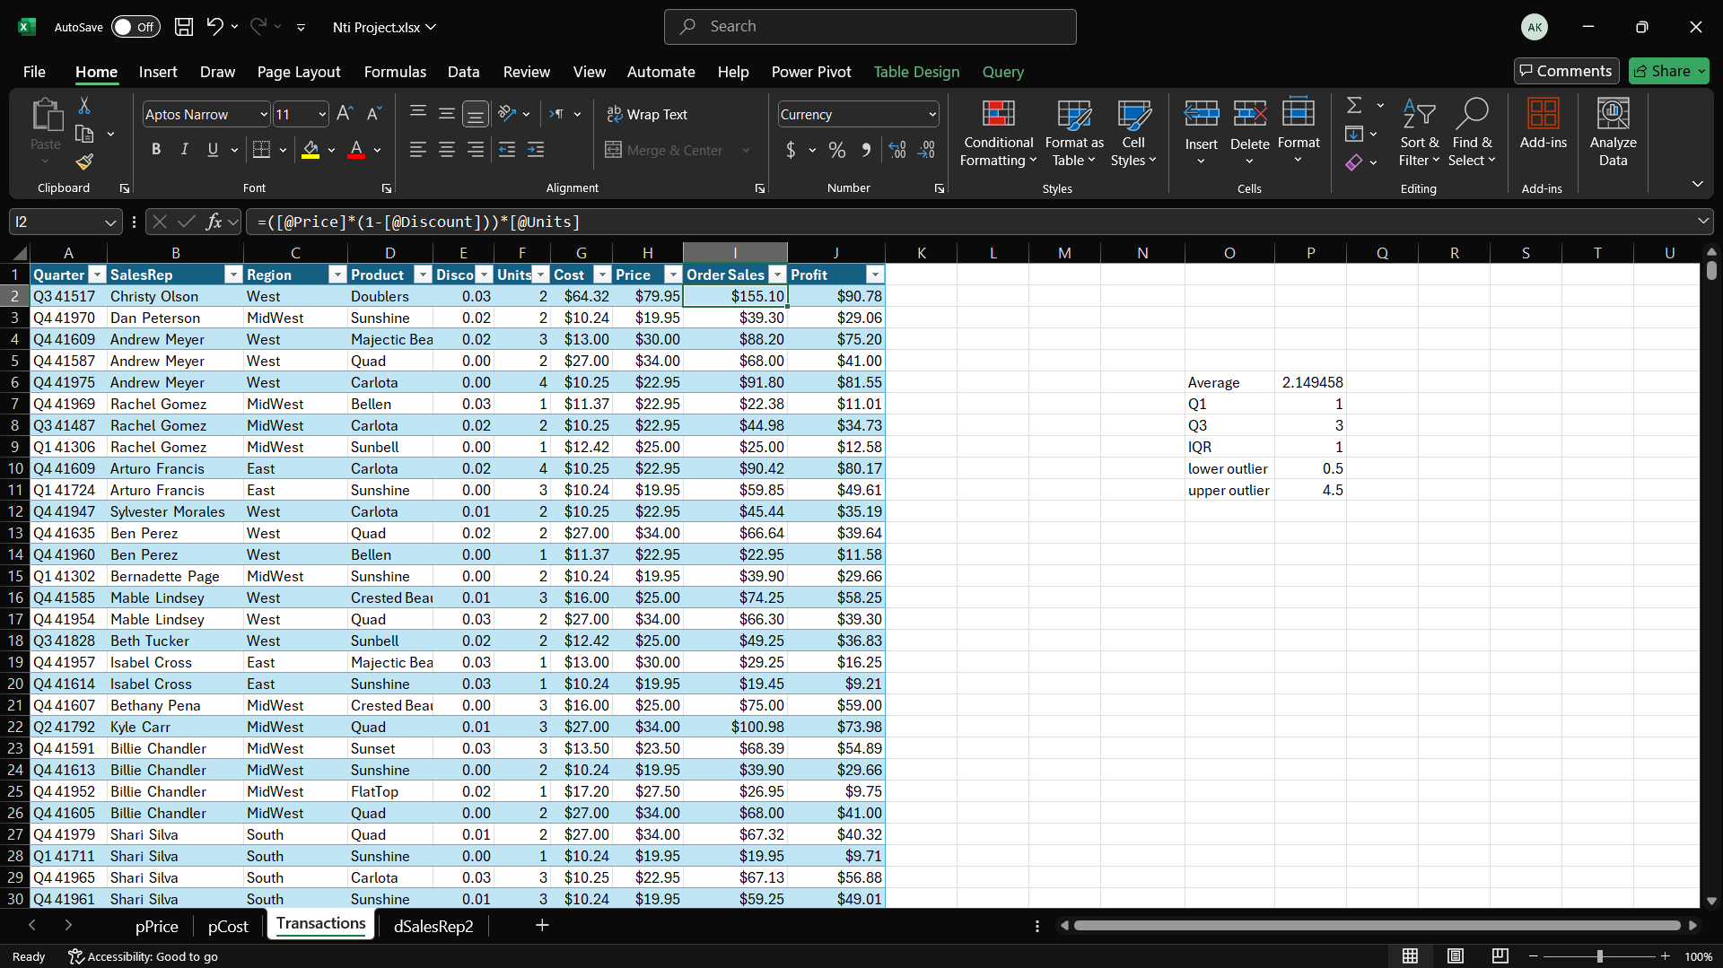
Project analysis slide 4
Excel

Slide 21
Python

Slide 22
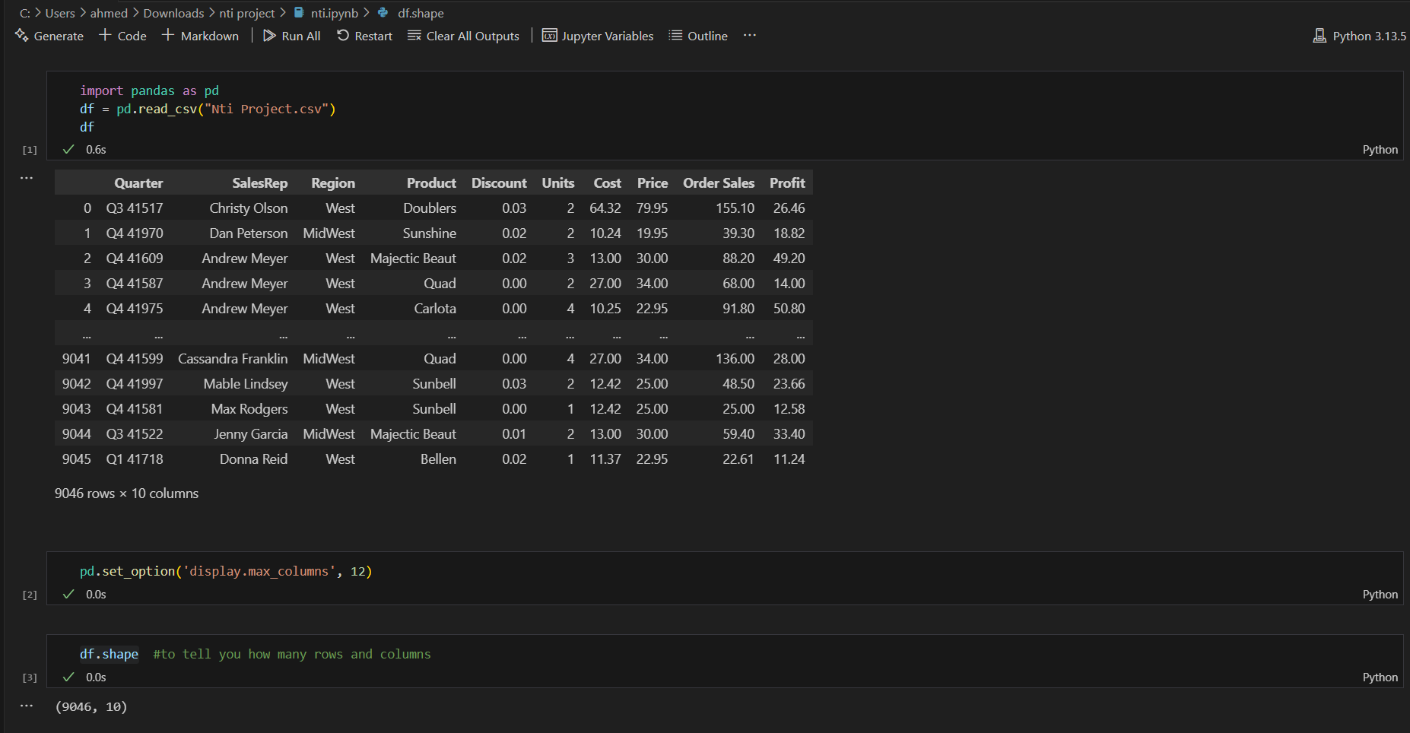
Project analysis slide 4
Python

Slide 23
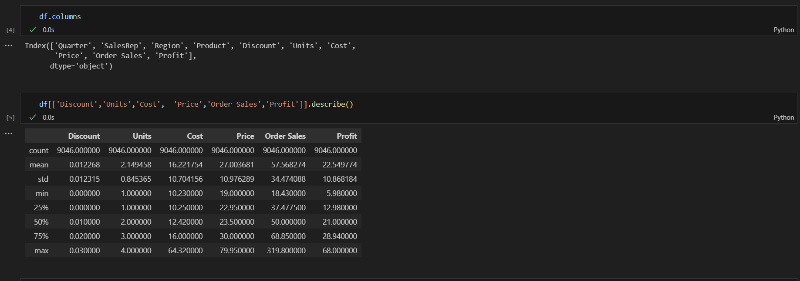
Project analysis slide 4
Python

Slide 24
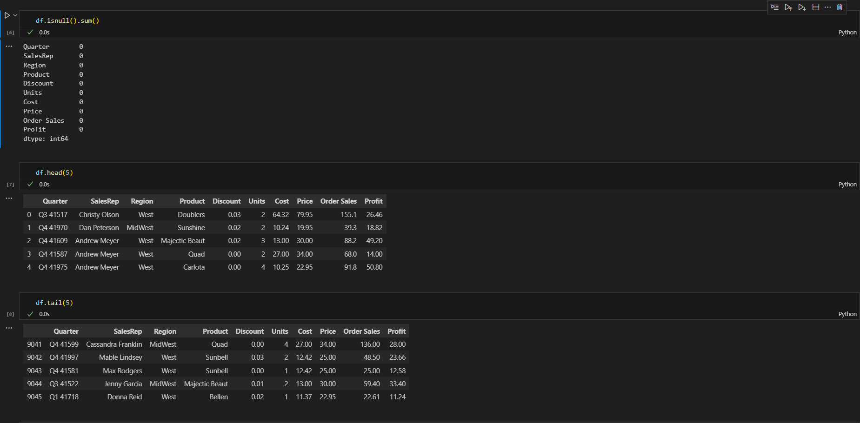
Project analysis slide 4
Python

Slide 25
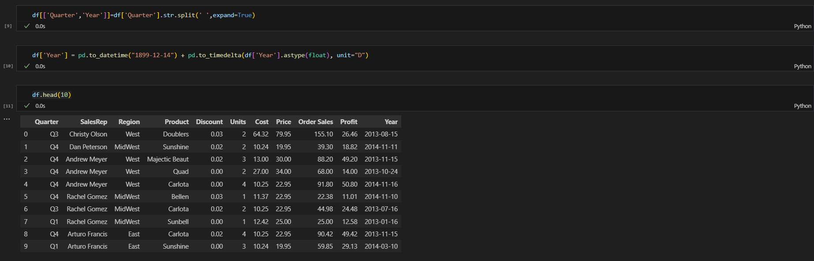
Project analysis slide 4
Python

Slide 26
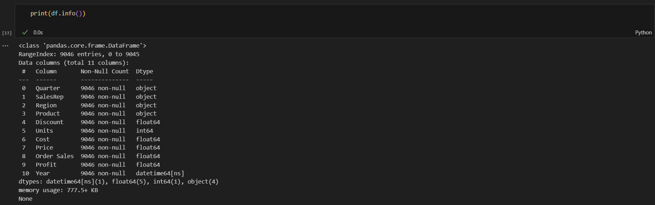
Project analysis slide 4
Python

Slide 27
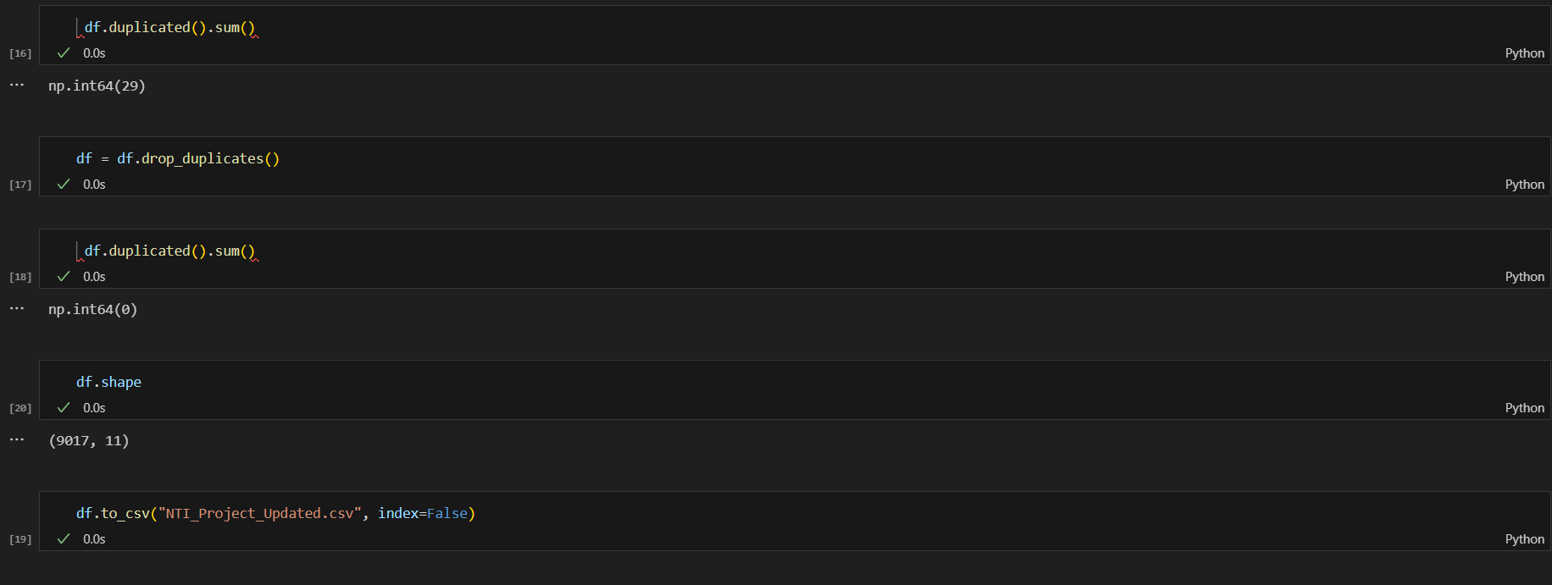
Project analysis slide 4
Python

Slide 28
Power Bi

Slide 29
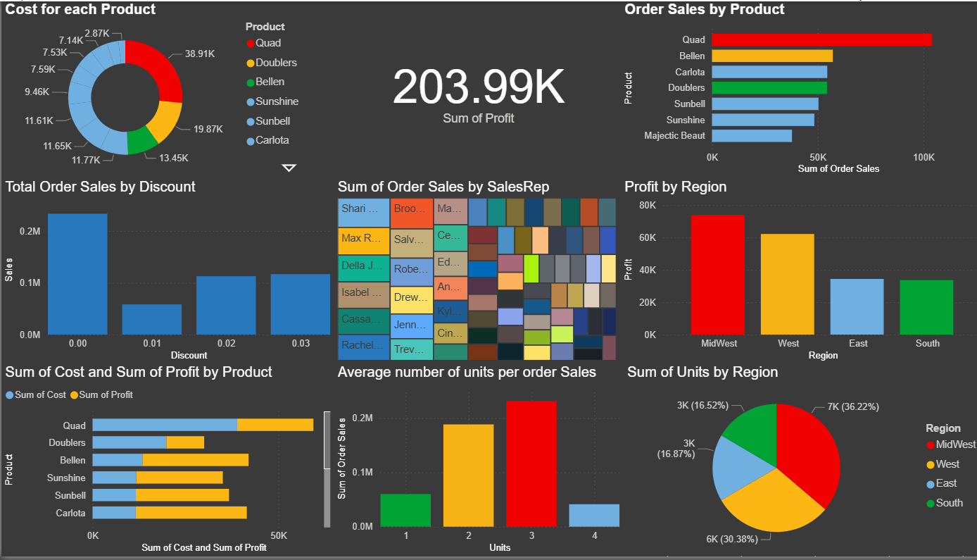
Project analysis slide 5
Power Bi

Slide 30
Thank You

